Slide 1
Generalization and Overfitting

Slide 2
Generalization
Generalization refers to your model's ability to adapt properly to new, previously unseen data, drawn from the same distribution as the one used to create the model.

Slide 3
100% Accuracy
Is 100% Accuracy a Good Thing?
- Dataset is small
- Dataset is extremely simplified
- Problem is simple
In real world situations, where there can N number of complications, it is very tough to build a model that captures the entire scene perfectly.
So: if the model is giving 100% accuracy for a real world problem, there is something wrong with the developers.

Slide 4
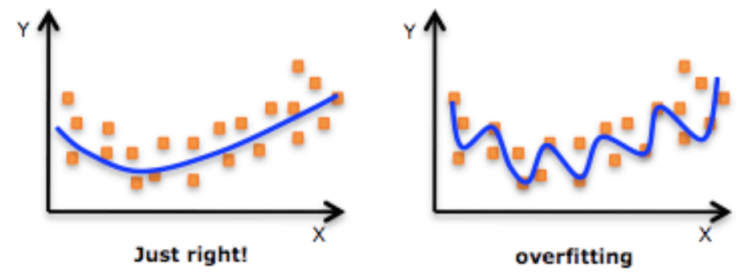
Overfitting
Overfitting is an undesirable machine learning behavior that occurs when the machine learning model gives accurate predictions for training data but not for new data. When data scientists use machine learning models for making predictions, they first train the model on a known data set.
In image on the right: The model is trying the learn the noise as well.
In the image on the left: The model is generalizing.

Slide 5
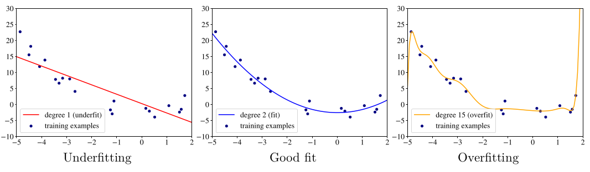
Examples of underfitting (linear model), good fit (quadratic model), and overfitting
(polynomial of degree 15).
Ref: Andriy Burkov - The Hundred-Page Machine Learning Book (2019)

Slide 6
Unseen Data and Train-Test-Split
How would you make sure that the model is generalizing well when the data is limited?
Answer:
We have to keep some part of the data aside for testing purpose.
We do not fit the model on 100% data.
20% or 25% or 30% or 33% so and so forth amount of data is kept separate for testing purpose.
That is how we get unseen data for the model using the train-test-split functionality of scikit-learn.

Slide 7
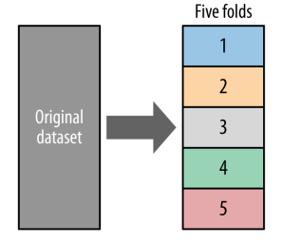
Cross-validation
The purpose of cross-validation is to use the original labeled data efficiently to estimate the performance of a modeling procedure. Here we show five-fold cross-validation: the original dataset is split randomly into five equal-sized pieces. Then, each piece is used in turn as the test set, with the other four used to train a model. The result is five different accuracy results, which then can be used to compute the average accuracy and its variance.
The key idea behind Cross-validation is:
In a train-test-split of 80% and 20%, who decides which elements constitute the 20%.

Slide 8
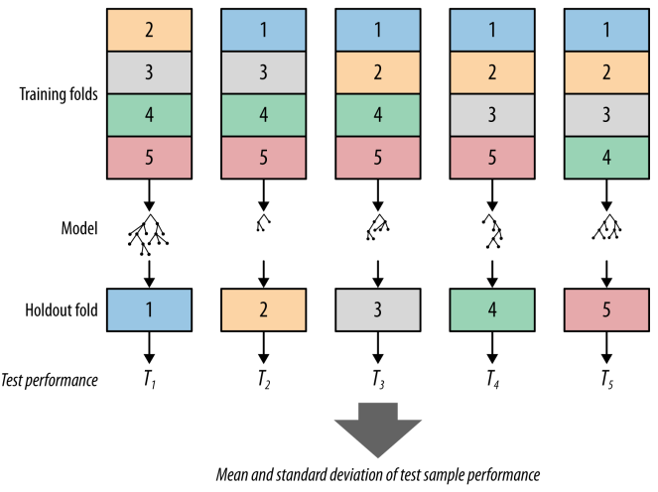
In cross-validation: we measure accuracy on all of the holdouts

